Slide 1
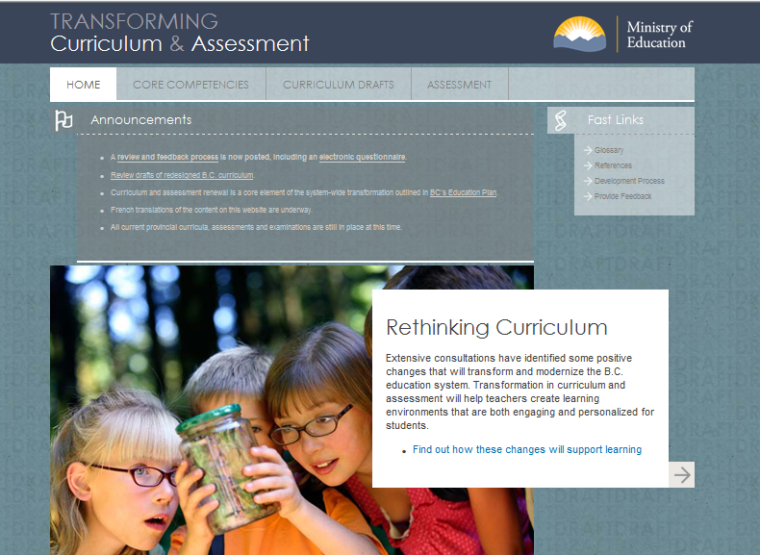
Curriculum Redesign
PITA CONFERENCE
May 8, 2015

Slide 2
Consultations & Development Process
Starting in 2011 through today:
Curriculum & Assessment Framework Advisory Group
Regional consultation sessions on curriculum and graduation
Enabling Innovation background paper
Exploring possible curriculum designs with educators/academics
Exploring Curriculum Design background paper
Competency definitions paper
Graduation program consultations
Curriculum development (K-9)
Competency development
Assessment and Curriculum Advisory Committees

Slide 3

Core Principles for Learning Environments
Makes Learning Central
Based on the Social Nature of Learning
Tuned into Emotions
Sensitive to Learner Differences
Challenging
Provides Clear Expectations and Descriptive Feedback
Promotes Connectedness
CORE PRINCIPLES FOR LEARNING ENVIRONMENTS, OECD

Slide 4
3 pillars support the development of the
BC Educated Citizen
3 PILLARS THAT SUPPORT THE DEVELOPMENT OF THE EDUCATED CITIZEN IN BC | DEFINITIONS
Literacy and Numeracy Foundations | grade level expectations for required skills in reading; writing; and numeracy expressed in the Performance Standards
Understanding and Application of Rich Content | prescribed learning standards for concepts and content in curriculum (areas of learning) expressed in the curriculum
Core Competencies | broad areas of development: thinking; communication; personal & social development expressed in the competency profiles

Slide 5
Guiding principles
Concept-Based, Competency-Driven Curriculum…
Core Competencies are explicit in redesign
Focus on the important concepts and big ideas inherent in the discipline
Emphasize higher order learning and deeper learning
Integrate and embed First Peoples Principles of Learning and Aboriginal knowledge and world views

Slide 6
Guiding principles
Reduce the prescriptive nature of curriculum
Allow for flexibility and choice for teachers and student
Enable teachers to be more creative and innovative in their design of learning experiences
Align assessment and evaluation with the redesign of the curriculum

Slide 7
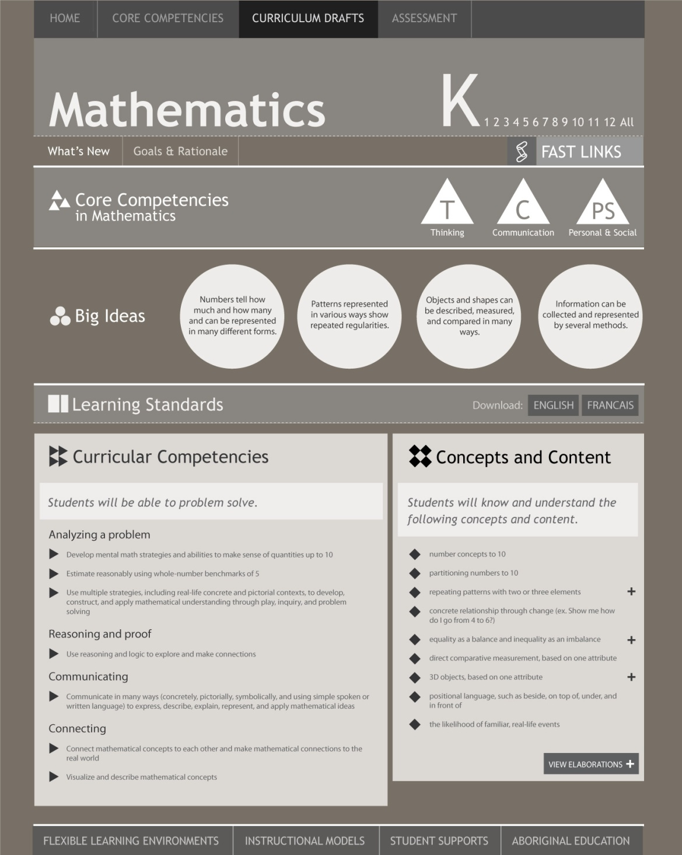
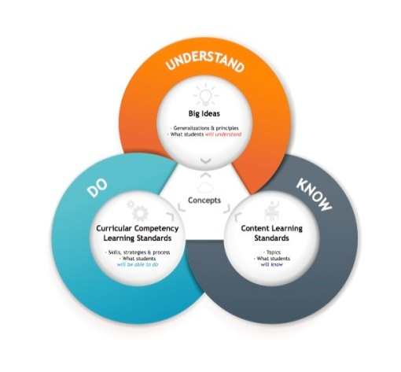
B.C.’s KDU (KUD) Curriculum Model
the 3-D curriculum model: Know, Understand, Be able to Do
B.C.’s KDU model
  content learning standards = what students will know
  curricular competency learning standards = what student will be able to do
  big ideas = what students will understand
Core Competencies are underpinning

Slide 8

BC’s Model: A Work in Progress
Core Competencies are underpinning

Slide 9
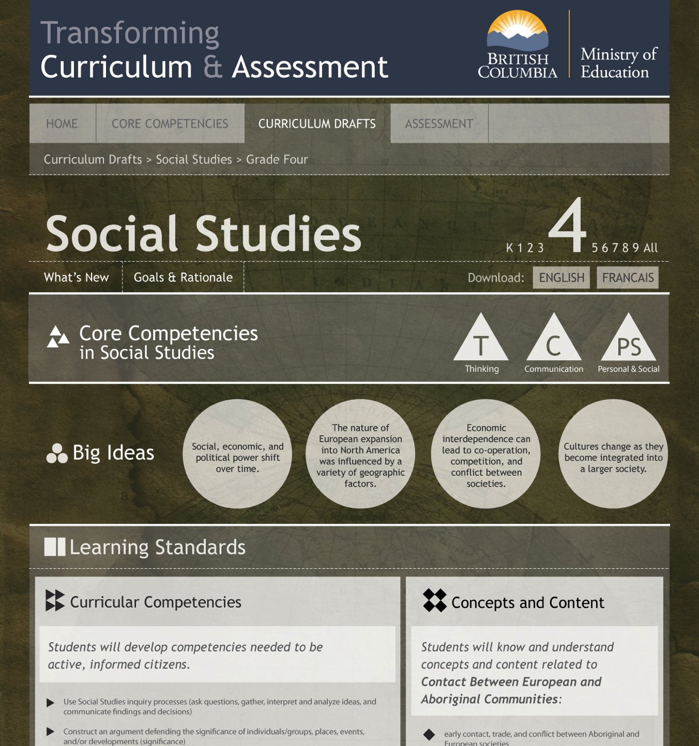
knKKN
Notes:
Development of a curriculum framework and draft of k-9 curriculum
The end of teaching everything – shift from content being the driver of what we focus on to competencies being the driver and content being the vehicle
Give teachers great opportunities and lots of space to be creative and do what they love versus covering the curriculum – plus cross curriculum
9

Slide 10
Graduation Curriculum: Proposed Directions

Slide 11
Curriculum Development
Areas of Learning (K-9):
English Language Arts
Mathematics
Science
Social Studies
Arts Education
Français Langue Seconde Immersion
Français Langue Premiere
Physical and Health Education
Languages (Core French) – underway
Applied Skills – under discussion
Career Education – underway

Slide 12
Curriculum K – 9
Revised versions posted: Summer 2015
Proposed legislation: Fall 2016
Areas of Learning:
English Language Arts
Mathematics
Science
Social Studies
Arts Education
Français Langue Seconde Immersion
Français Langue Première
Physical and Health Education
Languages (Core French) – 1st draft posted fall 2016
Career Education – 1st draft posted fall 2016
Applied Skills – reconceptualization underway

Slide 13
Curriculum 10 – 12
First outlines posted: Summer 2015
Areas of Learning:
English
Mathematics
Sciences
Social Studies
Arts Education
Physical and Health Education
In Process:
Français Langue Seconde Immersion
Français Langue Premiere
Languages (Core French)
Applied Skills – framework reconceptualized
Career Education – underway

Slide 14
Next steps for Curriculum Development
major editing process (West Coast Publishers)
Ministry internal reviews
translation into French
web enhancements (e.g., by grades, big ideas, multiple subjects)
ongoing collaboration with BCTF
Revised K-9 versions: Summer 2015 and available for use in BC schools
Proposed legislation for phasing in K-5/K-9: Fall 2016
Review & public input on first draft grad curriculum outlines

Slide 15
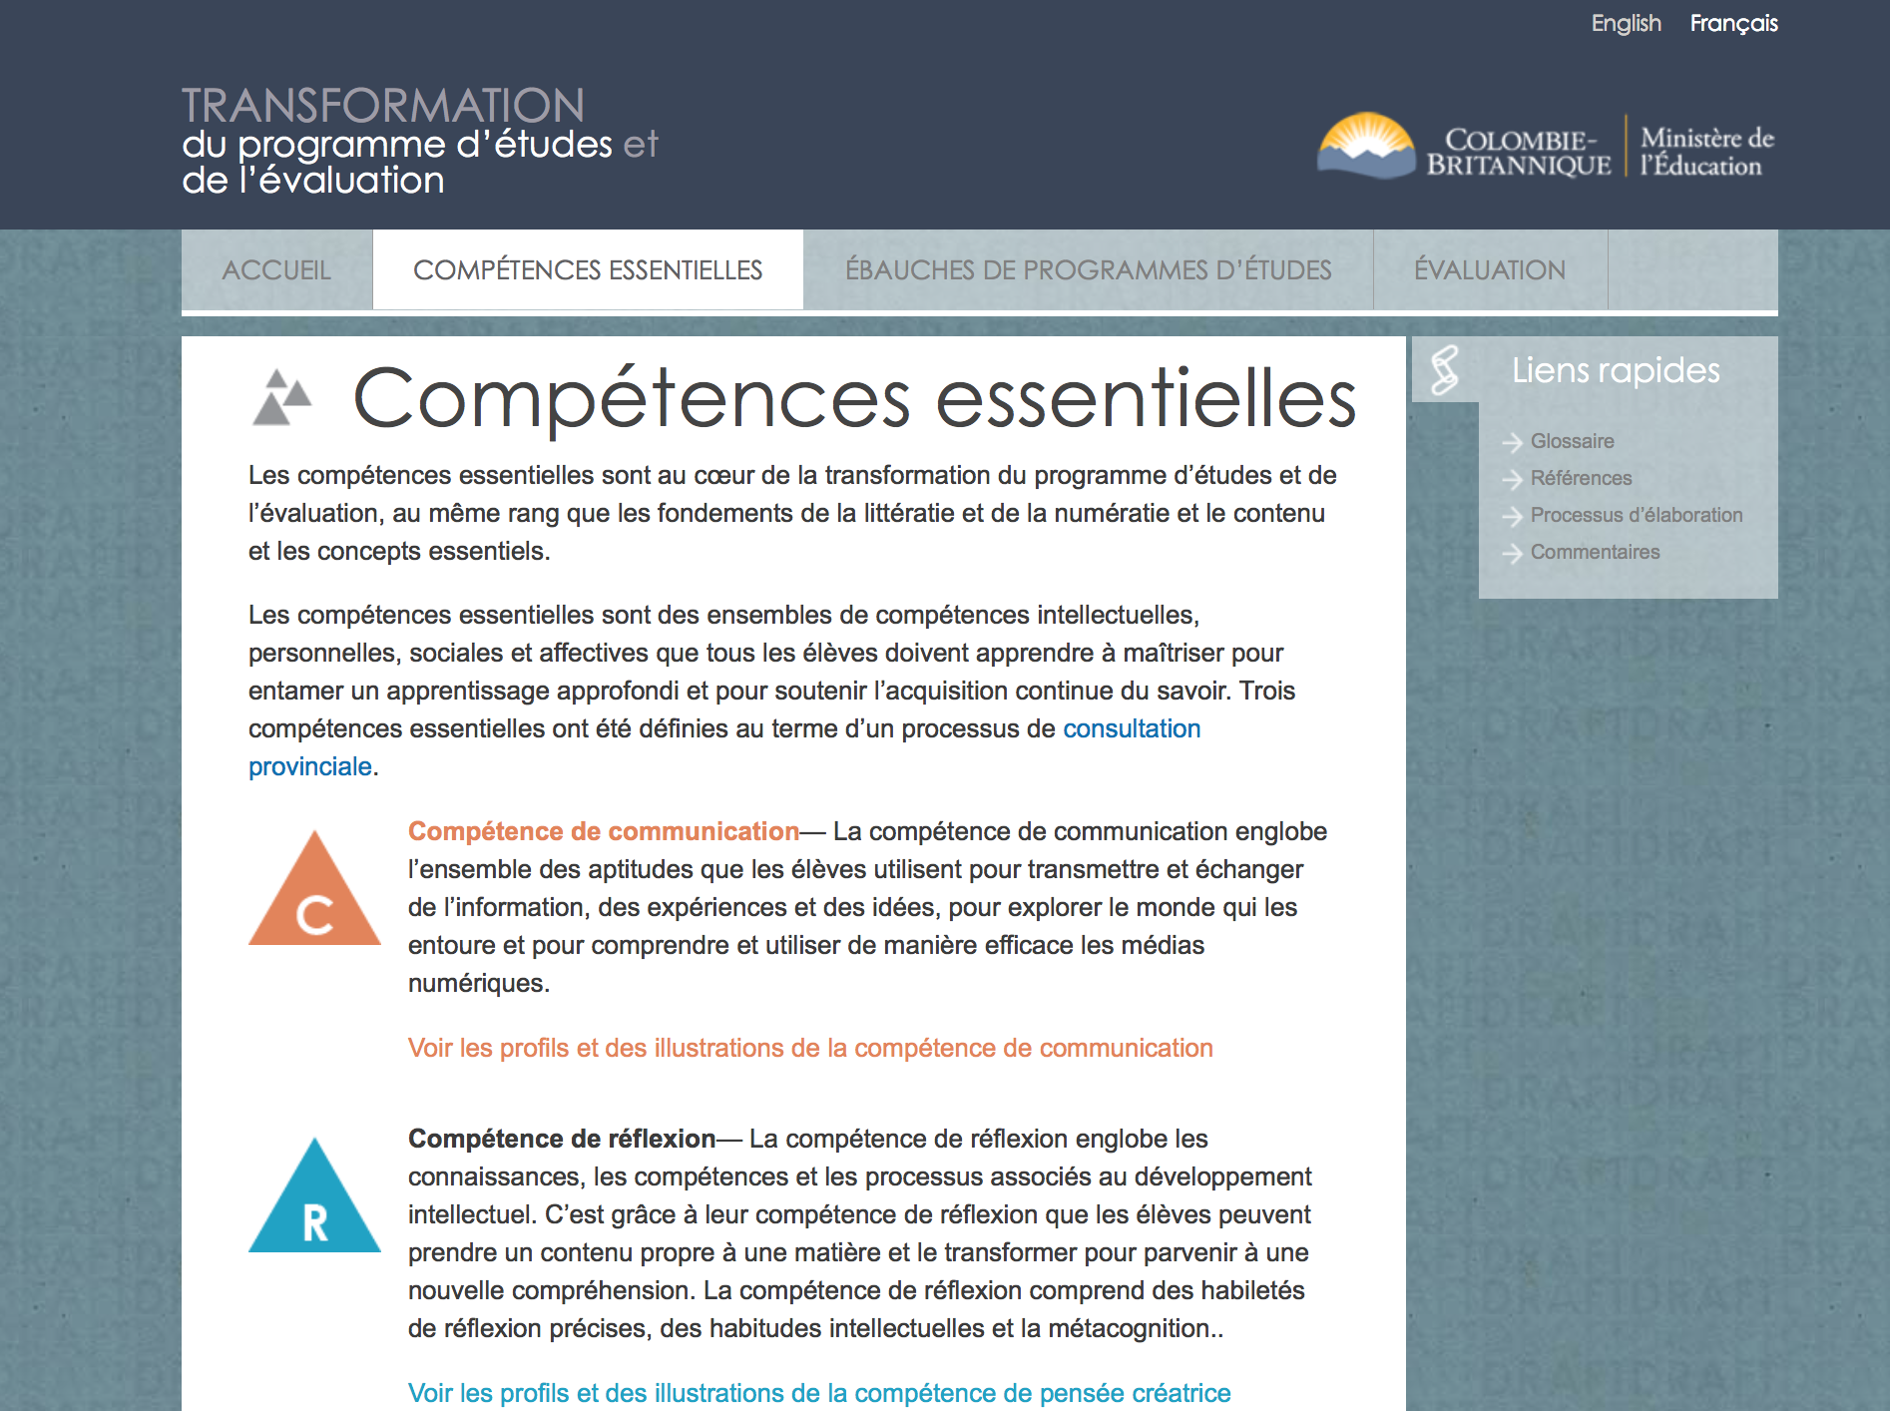

Slide 16
K – 9 Curriculum AND COMPETENCY Feedback Meeting with BC Teachers’ Federation
January 14, 2015

Slide 17


“The change and transformation is really not about curriculum.
It is actually about how we engage students in learning.”
LEARNING ENVIRONMENTS
(Nature of Learning)

Slide 18
What are the Implications of Transformation for the Ministry of Education?
Must begin to review:
Funding Formula
Capital spending
Reporting
Audits
Transcripts
Letter Grades
Graduation Credentialing
Required Areas of Study
Scholarships/Awards
Provincial Exams
Challenge/Equivalency
Teacher Education etc.

Slide 19
Yong Zhao
NEW PARADIGM AND WE MUST FOSTER:
enhancing everybody’s strengths and unique talents
students owning their own learning
schools as a museum: curriculum follows the child
FIX THE PAST? OR INVENT THE FUTURE?

Slide 20
for discussion …
What are you doing or planning to do next year, to focus on the revised curriculum and competencies?
Given the changing emphases in the curriculum, what do you need to support your work going forward?
What do you recommend be phased in for the fall of 2016: K-5 or K-9?

Slide 21

BC COMPETENCY WORK TO DATE
May, 2015

Slide 22
Core Competencies
Provincial consultation and extensive research identified these categories of core competencies that support life-long learning:
  Thinking Competency
    Critical thinking
    Creative thinking
  Communication Competency
    (oral, written, visual, digital; includes collaboration and reflection)
  Personal and Social Competency
    Positive personal and cultural identity
    Personal awareness and responsibility (includes self-regulation)
    Social awareness and responsibility

Slide 23
Components in developing competency profiles
Three interrelated sources:
Feedback from the Aboriginal scholars, knowledge-keepers
Research presented in Defining Cross-curricular competencies
Field work in 22 districts to date

Slide 24
CONNECTIONS: COMPETENCIES AND FIRST PEOPLES PRINCIPLES OF LEARNING
https://firstpeoplesprinciplesoflearning.wordpress.com/

Slide 25
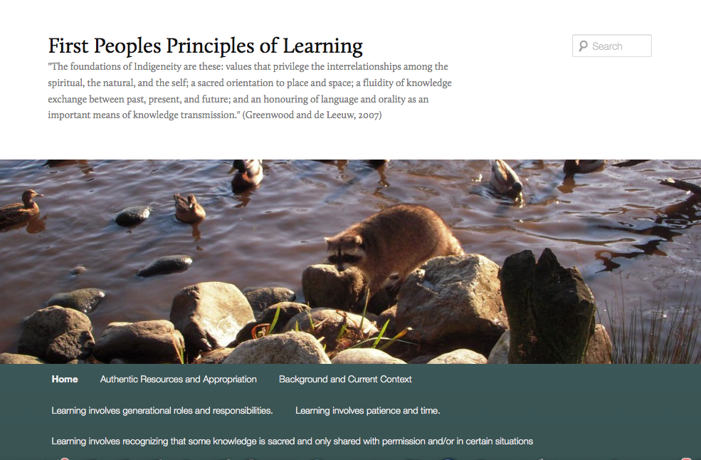

Slide 26
Authenticity: Developed by BC Educators
grounded in current BC classrooms
illustrations “observed” in ordinary, amazing classrooms not “created” as showpieces
authentic profiles – the number of profiles reflects what we/teachers observed; the descriptions describe work that exists

Slide 27
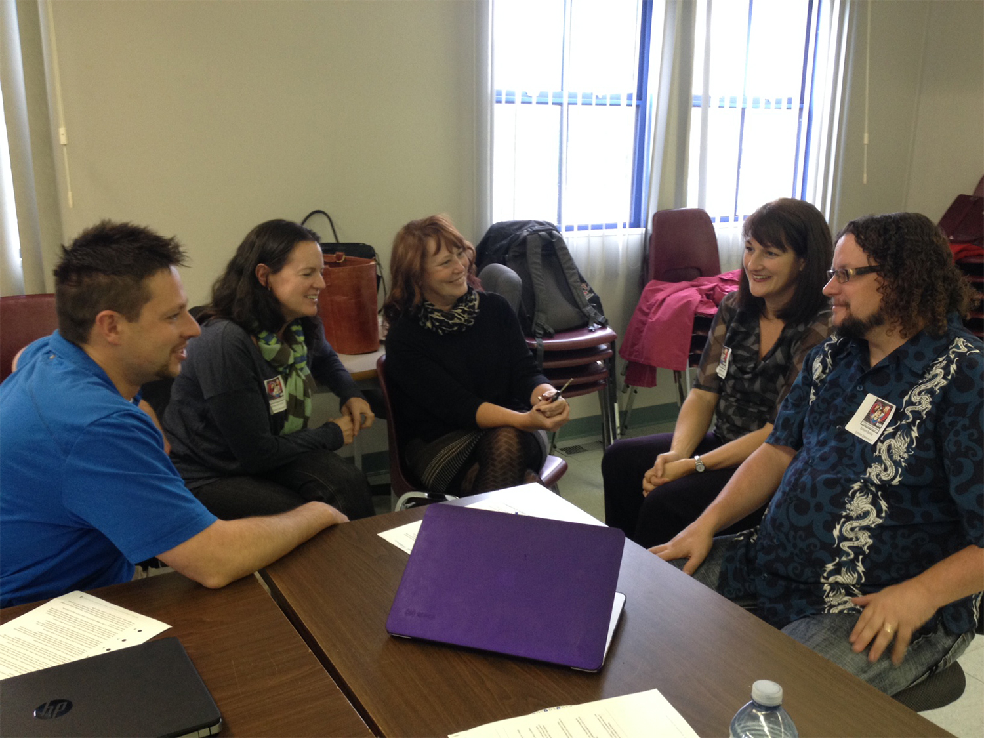

Slide 28
BC Core Competencies
CHARACTERISTICS
INCLUSIVE: every student has a profile
CROSS-CURRICULAR: evident in all curricular areas
STRENGTH-BASED: each competency continuum emphasis the concept of expanding and growing
STUDENT-CENTERED: based on actual samples from BC students and grounded in “I” statements
DESCRIPTIVE AND PROGRESSIVE: profiles of progression from early childhood through adult expertise

Slide 29
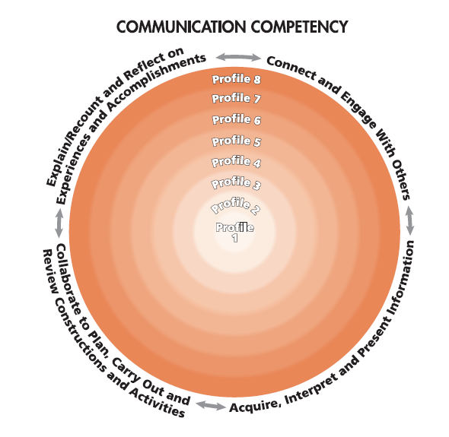

Slide 30
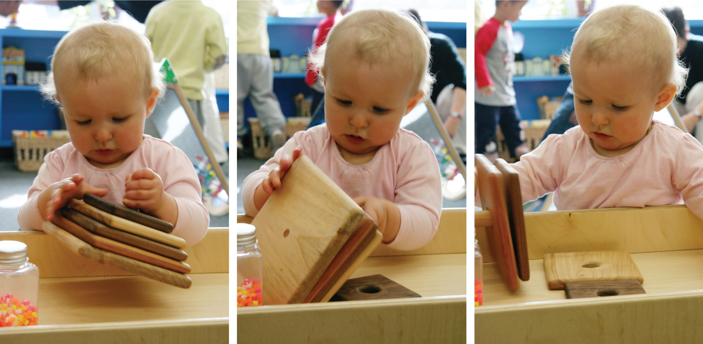
Georgia Determined
How do I get these out?
What happens if I turn it over?
Success!

Slide 31
Core Competencies
Communication: Profiles and 23 illustrations posted
Positive Personal & Cultural Identity: Profiles and 19 illustrations posted
Creative Thinking: Profiles and 31illustrations posted
Critical Thinking: Profiles and 20 illustrations will be posted April/May, 2015
Personal Responsibility: Coming June 2015
Social Responsibility: Coming June 2015

Slide 32
What are BC Teachers already doing?
exploring and becoming familiar with the provincial curriculum, and focusing on a specific discipline
planning lessons/themes/interdisciplinary practises utilizing the redesigned learning standards, competencies, and big ideas which encompass what students will know, understand, and be able to do and using this structure for planning and assessment
developing different planning constructs for curriculum delivery – themes, inter-disciplinary, project/problem based
incorporating innovative classroom practices such as (problem based/project based, genius hour, maker spaces, community connections, service learning)

Slide 33
What are BC Teachers already doing?
focusing on competency development in Thinking, Communication and Personal and Social Competence
meeting in ‘book clubs’ to have conversations on how to “activate” the competencies in their classrooms
inquiring into different structures – moving away from structures and approaches that impede innovation
connecting through networks of innovative practices to inspire and motivate and create momentum

Slide 34
What are BC Teachers already doing?
using the core competencies in English Language Arts, Social Studies, Science, Arts (e.g., what profile best represents a person/character and what evidence supports your thinking? – both fiction and non-fiction)

